Slide 1
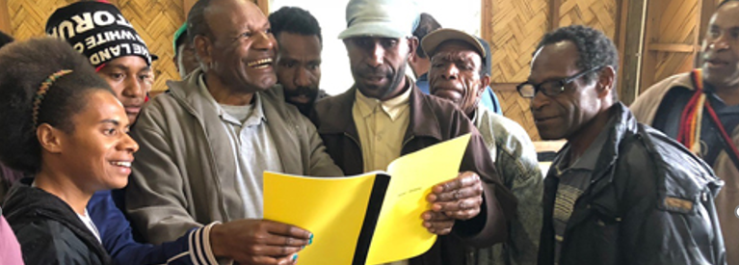
So Ezra the priest brought the Law before the assembly of men and women and all who could hear with understanding on the first day of the seventh month. Then he read from it in the open square that was in front of the Water Gate from morning until midday… And Ezra opened the book in the sight of all the people, for he was standing above all the people; and when he opened it, all the people stood up. And Ezra blessed the LORD, the great God. Then all the people answered, “Amen, Amen!” while lifting up their hands. And they bowed their heads and worshiped the LORD with their faces to the ground (Neh. 8:2-3a, 5-6).
All Scripture is taken from the New King James Version®. © 1982 by Thomas Nelson, Inc. Used by permission. All rights reserved.
Community Acceptance

Slide 2
1 Corinthians 9:22
to the weak I became as weak, that I might win the weak. I have become all things to all men, that I might by all means save some.

Slide 3
?

Slide 4
Luke 14:28-29
For which of you, intending to build a tower, does not sit down first and count the cost, whether he has enough to finish it— ²⁹ lest, after he has laid the foundation, and is not able to finish, all who see it begin to mock him,

